Slide 1


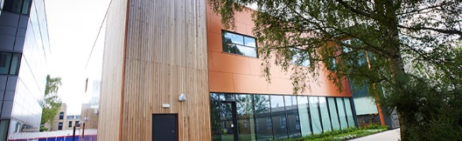
HSPiP for Greener Solid Phase Organic Synthesis (SPOS)
Stefan Lawrenson – 3rd Year PhD
sbl506@york.ac.uk
6 April 2017

Slide 2
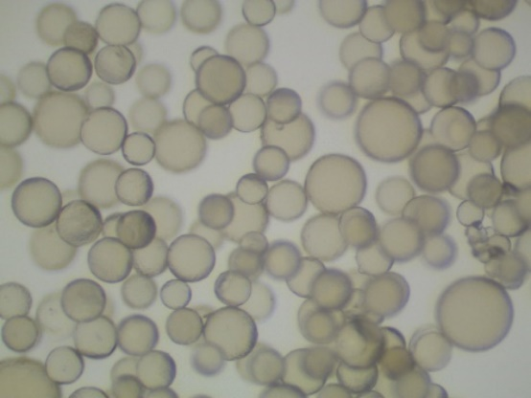
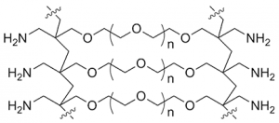
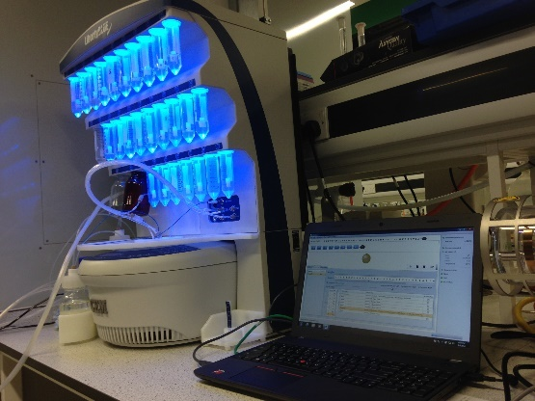
Contents
  What is Solid-Phase Organic Synthesis (SPOS)?
  - Why are solvents a problem?
  - Solvent considerations in SPOS
  Swelling common SPOS resins in green solvents
  Application of this work in greener SPOS
  - Solid-Phase Peptide Synthesis (SPPS)
  - Solid supported UGI reaction
  Modelling of the solid support using HSPiP
  Conclusions

Slide 3
What is Solid-Phase Organic Synthesis (SPOS)?
Traditional Solution-Phase Chemistry:
Solid-Phase Chemistry:
Addition of reagents
Simple filtration
  Simple purification and work-up (Automated)
  No need for recrystallisations, distillations or column chromatography etc.
  Application in flow synthesis

Slide 4


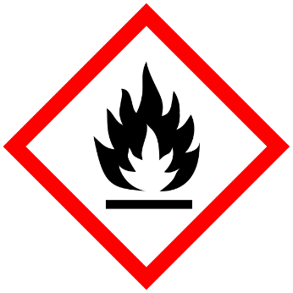
Greener SPOS
  Solvent use typically constitutes 80-90% of mass utilisation in a typical batch pharmaceutical/fine-chemical process^{[1]}
  On average 56% of the mass used to produce 1kg of an API comes from the solvent^{[2]}
  About 83% of all amide bond forming reactions are carried out in DCM or DMF^{[3]}
  Solid-Phase Peptide Synthesis (SPPS) is often performed in a combination of undesirable solvents (DCM, NMP, DMA, DMF)
[1]. D. J. C. Constable, C. Jimenez-Gonzalez, R. K. Henderson, Org. Process Res. Dev., 2007, 11, 133-137.
[2]. R. K. Henderson et al., Green Chem., 2011, 13, 854-862.
[3]. D. S. MacMillan, J. Murray, H. F. Sneddon, C. Jamieson, A. J. B. Watson, Green Chem., 2013, 15, 596-600.

Slide 5
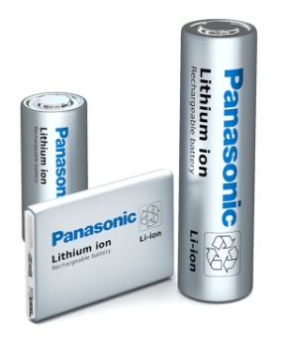
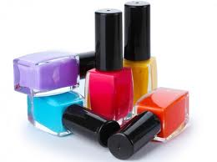
Cyclic Carbonates for SPPS
  Cyclic carbonates as greener solvents for Solid-Phase Peptide Synthesis (SPPS)
  Produce no NO_{x} or SO_{x} upon incineration
  Non-toxic
  Biodegradable
  Can be produced via the 100% atom economical reaction between epoxides and CO₂ (CCU – Carbon Capture and Utilisation)^{[4]}
  Already produced on a commercial scale
[4]. J. W. Comerford, I. D. V. Ingram, M. North, X. Wu, Green Chem., 2015, 17, 1966-1987.

Slide 6
Cyclic Carbonates for SPPS
  Solution-phase control reactions^{[5]}
Entry | Base | Solvent | X⁻ | Yield (%)
1 | 4M HCl | 1,4-Dioxane | Cl⁻ | 93
2 | HCl | PC | Cl⁻ | 89
3 | CF₃COOH | PC | CF₃COO⁻ | 99
Entry | Coupling Agent/Additive | Base | Solvent | Yield (%)
1 | EDC:HOAt | NaHCO₃ | CH₂Cl₂:DMF | 86^{[6]}
2 | DCC:PFP | Et₃N | CH₂Cl₂:DMF | 76
3 | DCC:PFP | Et₃N | PC | 83
4 | DCC:PFP | Et₃N | EC | 96*
5 | EDC:HOBt | iPr₂EtN | PC | 93
6 | EDC:HOBt | iPr₂EtN | CH₂Cl₂:DMF | 81
7 | EDC:HOBt | iPr₂EtN | DMF | 83
* Reaction carried out at 40 °C
[5]. S. B. Lawrenson, R. Arav, M. North, Green Chem., 2017, DOI:10.1039/C7GC00247E
[6]. J. Nam, D. Shin, Y. Rew, D. L. Boger, J. Am. Chem. Soc., 2007, 129, 8747-8755.

Slide 7
Tetrapeptide Synthesis
  Synthesis of a range of tetrapeptides using PC as the only reaction solvent
      Efficient couplings (65 – 91%) and deprotections (83 – 99%)
      No evidence for epimerisation (>99:1 stereoselectivity)
[5]. S. B. Lawrenson, R. Arav, M. North, Green Chem., 2017, DOI:10.1039/C7GC00247E

Slide 8
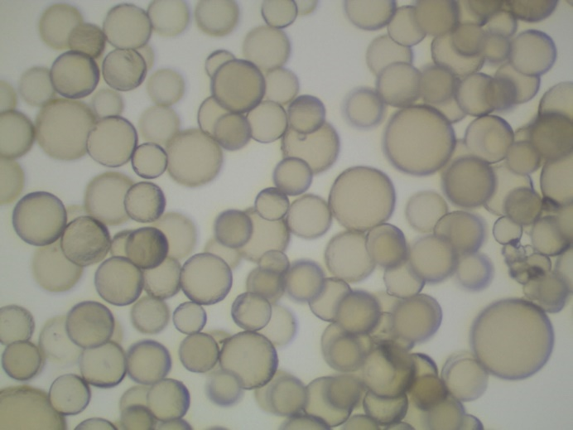
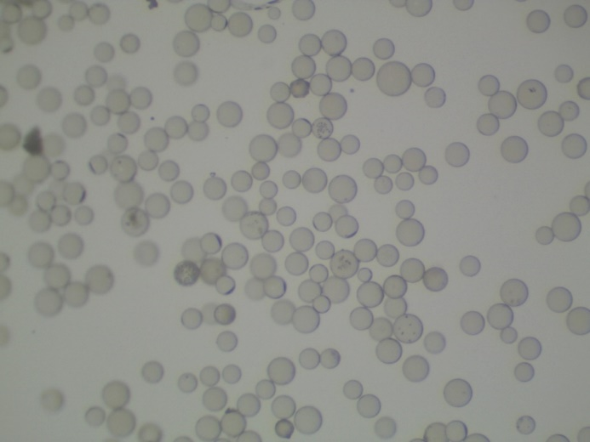
Solvent Considerations
  Solvation (Swelling) of the resin is one of the most important considerations in SPOS
  Poor swelling results in poor reaction site accessibility and diminished reaction rates
  Has previously been studied by measuring the increase in volume occupied by a resin in a syringe following the addition of solvent^{[7]}
  Greater than 4.0 mL g⁻¹ is a good solvent
  Between 2.0-4.0 mL g⁻¹ a moderate solvent
  Less than 2.0 mL g⁻¹ a poor solvent
[7]. R. Santini, M. C. Griffith M. Qi, Tetrahedron Lett., 1998, 39, 8951-8954,

Slide 9
Resin Swelling in Green Solvents
How will common SPOS resins swell in various green solvents?^{[8]}
Polystyrene (PS) - Merrifield, JandaJel, ParaMax
Polyethylene Glycol (PEG) - ChemMatrix
PEG-PS Hybrids - ArgoGel, HypoGel 200, NovaGel
TentaGel
Polyamide (PA) - SpheriTide
[8]. S. Lawrenson, M. North, F. Peigneguy, A. Routledge, Green Chem., 2017, 19, 952-962.

Slide 10
Resin Swelling in Green Solvents
How will common SPOS resins swell in various green solvents?^{[8]}
Polystyrene (PS) - Merrifield, JandaJel, ParaMax
Polyethylene Glycol (PEG) - ChemMatrix
PEG-PS Hybrids - ArgoGel, HypoGel 200, NovaGel
TentaGel
Polyamide (PA) - SpheriTide
[8]. S. Lawrenson, M. North, F. Peigneguy, A. Routledge, Green Chem., 2017, 19, 952-962.

Slide 11
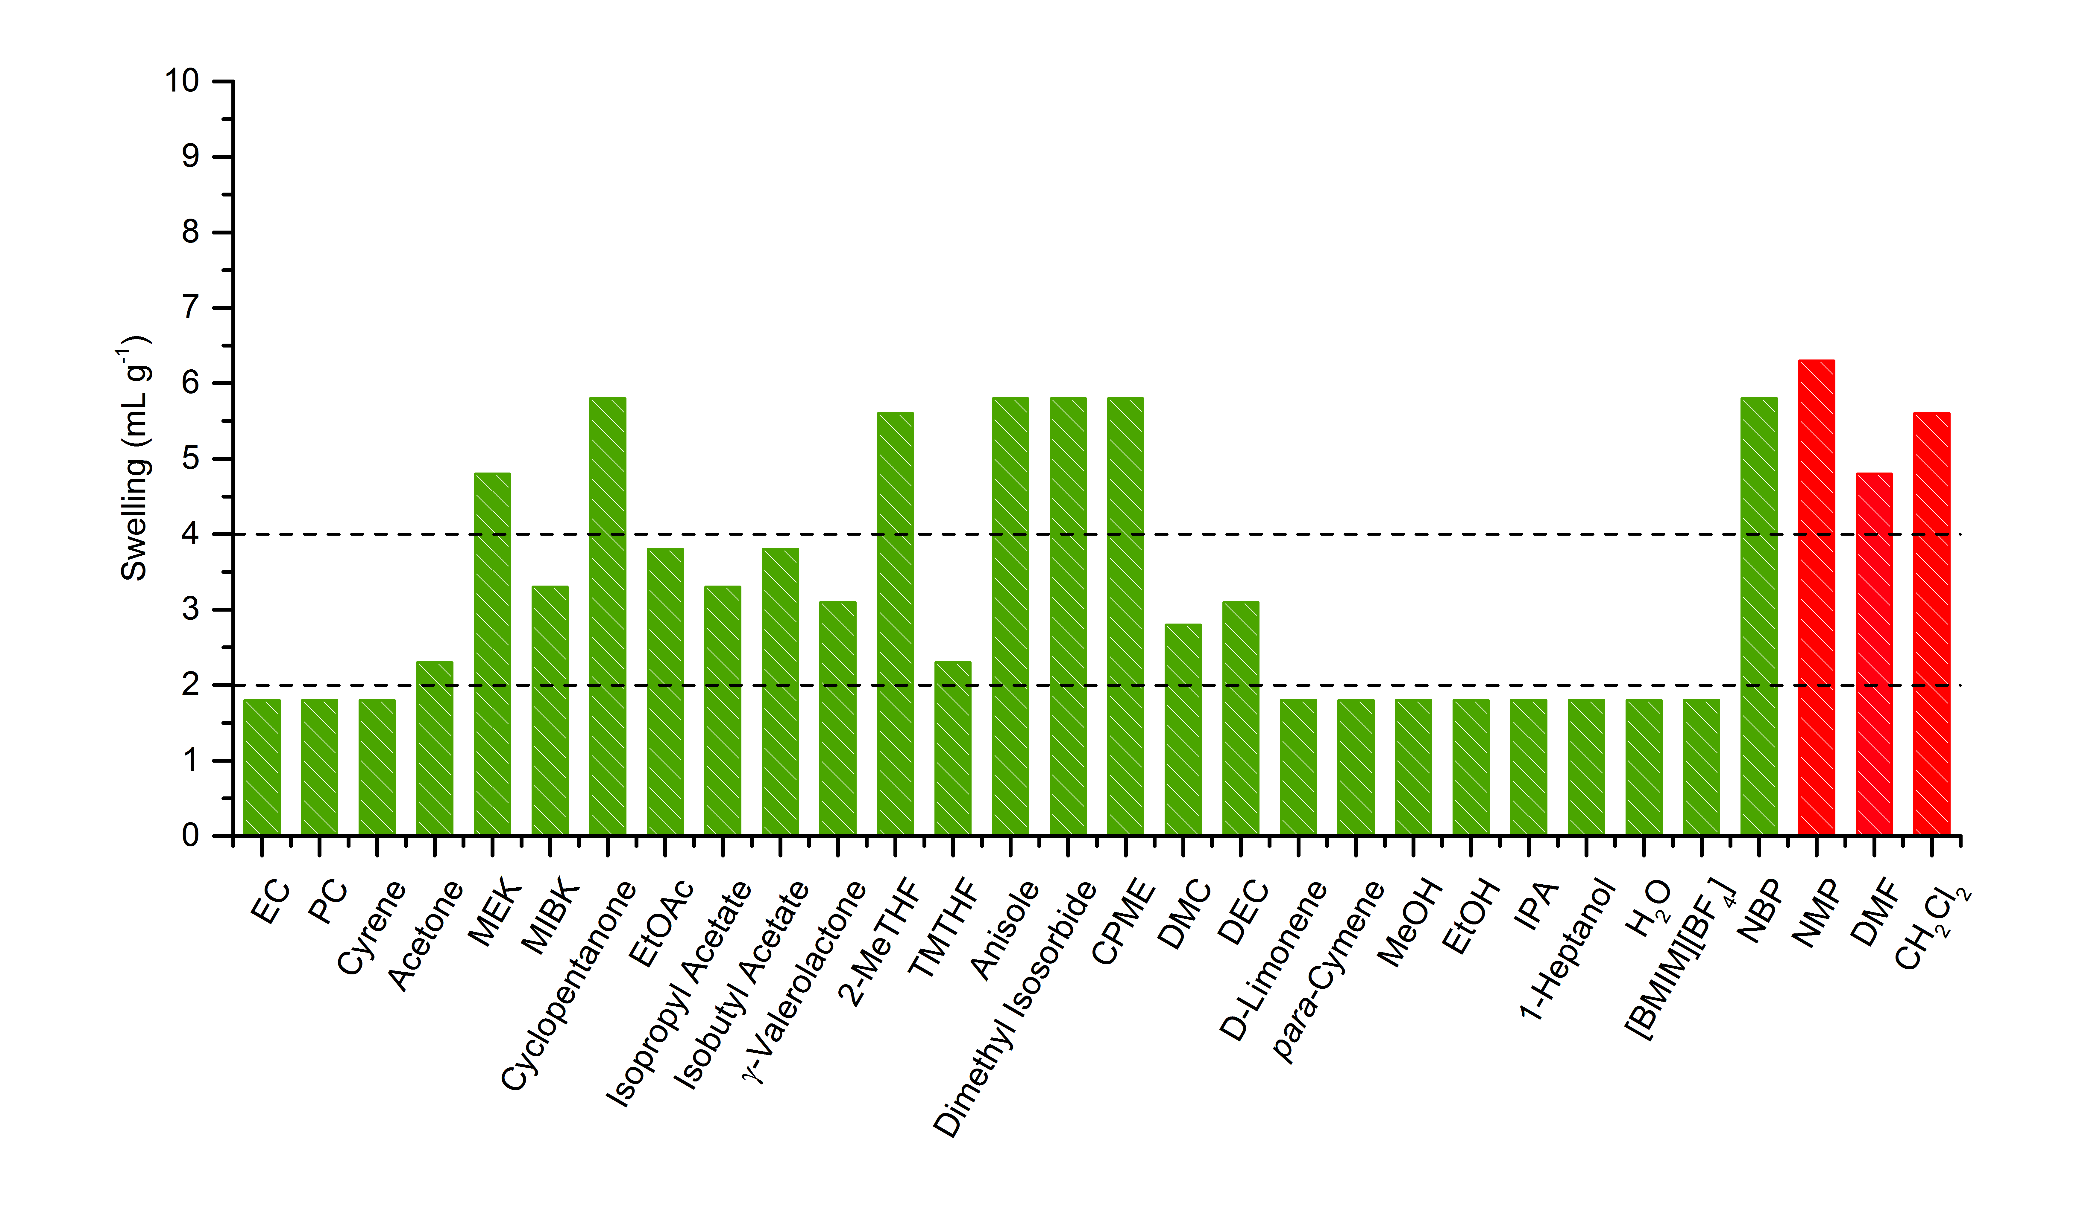
Merrifield Resin Swelling
  Polystyrene

Slide 12
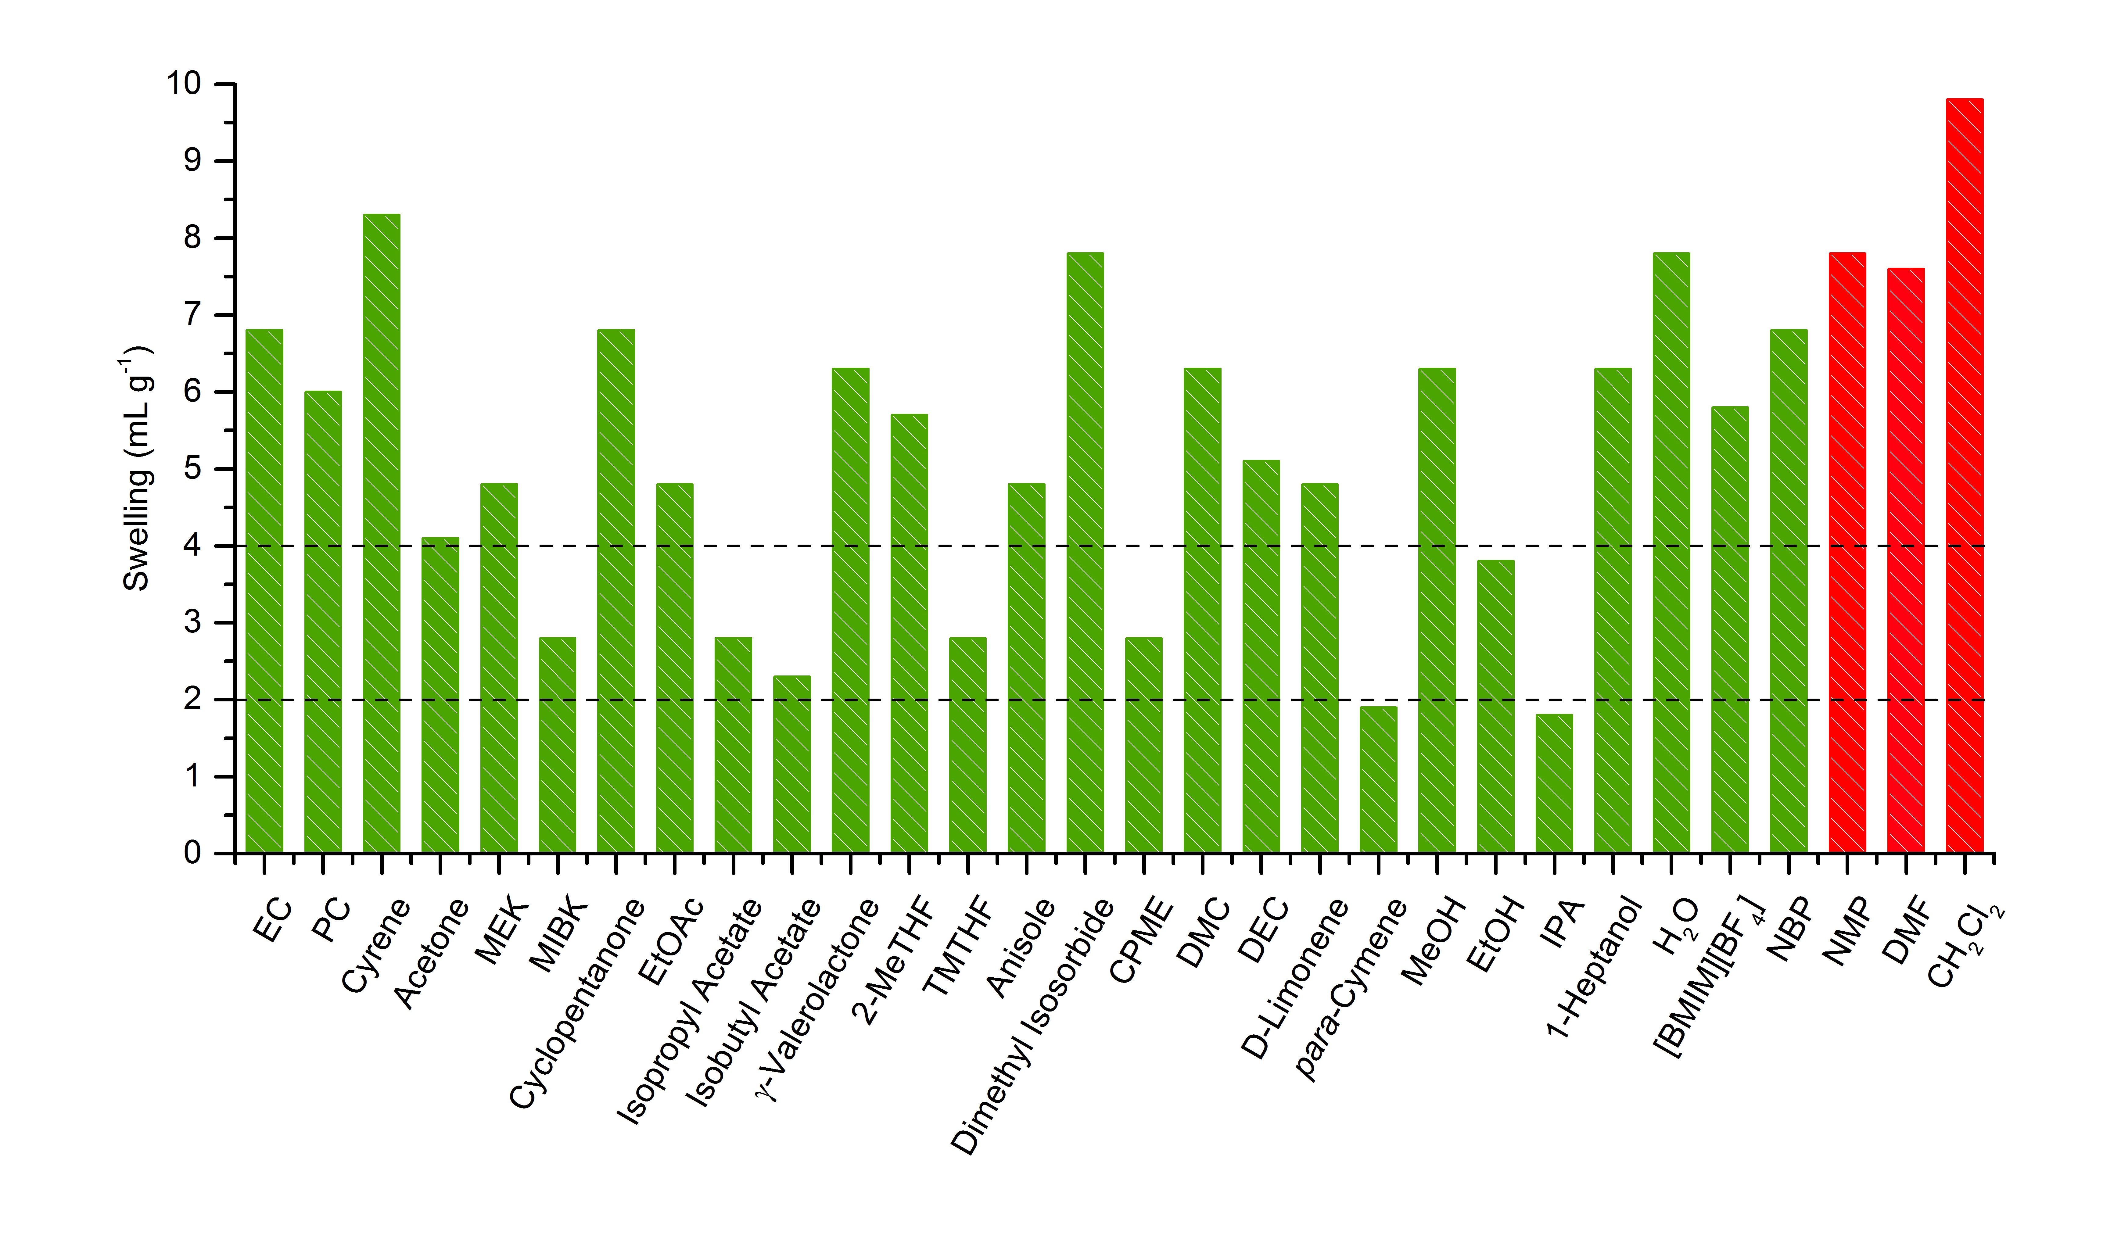
ChemMatrix Resin Swelling
  Polyethylene Glycol

Slide 13
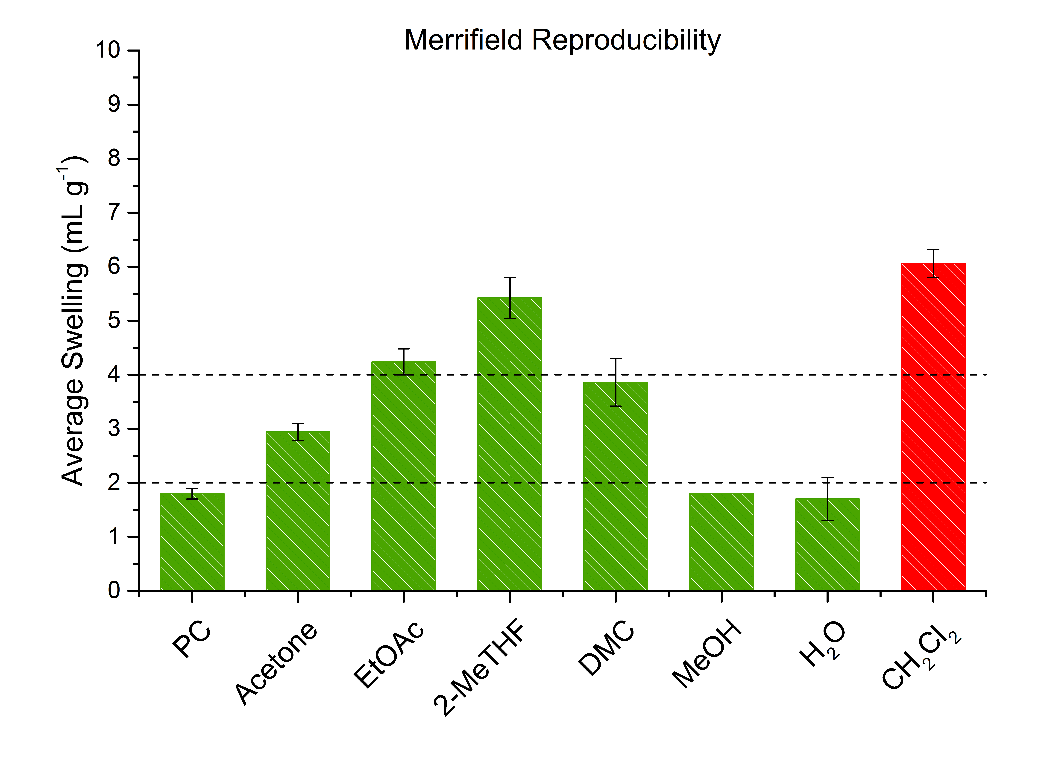
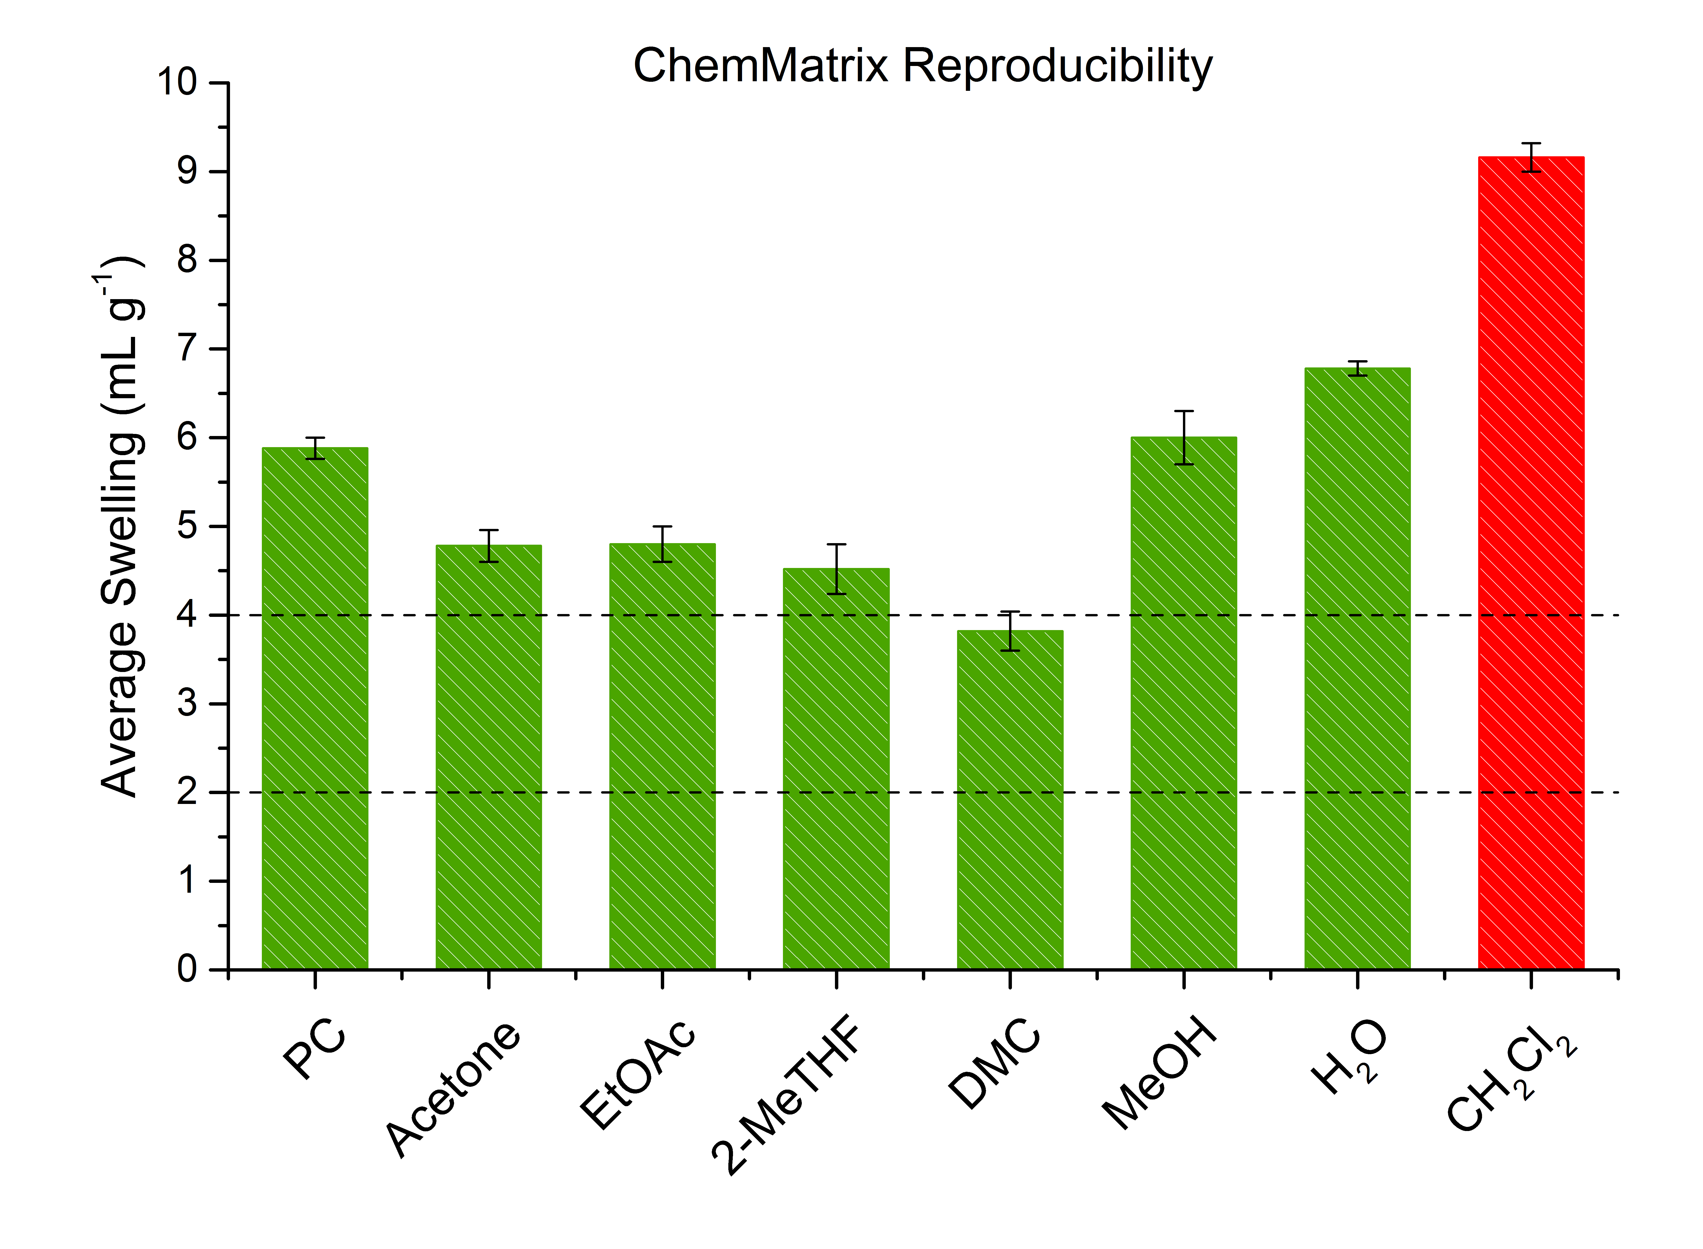
Reproducibility
  All swelling values were found to be reproducible within ±0.5 mL g⁻¹

Slide 14
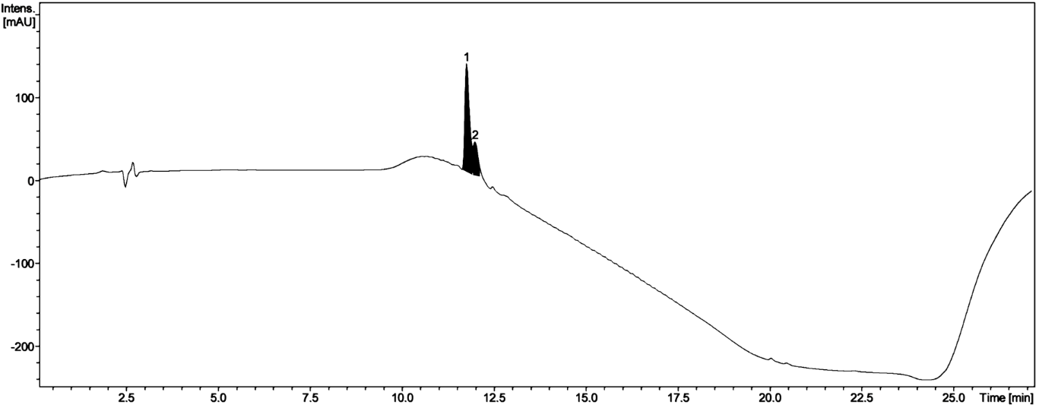
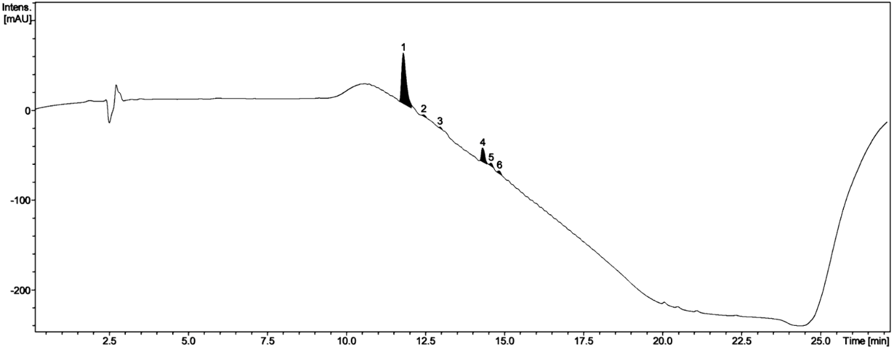

Cyclic Carbonates for SPPS
  Cyclic carbonates are unable to swell PS (Merrifield) based resins but will adequately swell PEG (ChemMatrix) based resins
Synthesis of a biologically relevant peptide (bradykinin)
  Sample prepared in DMF (Left) – 79% crude purity
  Sample prepared in PC (Right) – 77% crude purity
[5]. S. B. Lawrenson, R. Arav, M. North, Green Chem., 2017, DOI:10.1039/C7GC00247E

Slide 15
Application in Organic Synthesis
Multicomponent Reactions (MCR)
Ugi Reaction
Biginelli Reaction
Organocatalysis
Peptide Catalysed Aldol Reaction

Slide 16
Application in Organic Synthesis
Solution Phase Ugi Reaction
Solid Phase Ugi Reaction

Slide 17
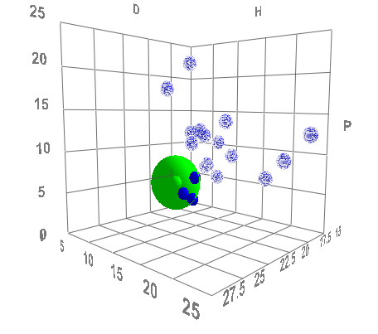
HSPiP for Predicting New Green Solvents
  HSPiP represents solvents as points in three dimensional space according to their dispersion (δD), polar (δP) and hydrogen bonding (δH) energies
  Can the observed swelling results be used to predict additional green solvents?
2-MeTHF
p-Cymene
D-Limonene
Solvent | δD | δP | δH | R
Polystyrene | 18.50 | 4.50 | 2.90 | 4.00

Slide 18
HSPiP for Predicting New Green Solvents
Merrifield Resin JandaJel Resin
Solvent | δD | δP | δH
CH₂Cl₂ | 17.00 | 7.30 | 7.10
2-MeTHF | 16.90 | 5.00 | 4.30
Polystyrene | 18.50 | 4.50 | 2.90
Solvent | δD | δP | δH
GVL | 17.90 | 11.50 | 6.30
Polystyrene | 18.50 | 4.50 | 2.90
  Lots of structural factors can influence swelling (Cross-Linker, Polymer Backbone, Linker, Loading)
  Resin can not simply be regarded as equivalent to the polymer

Slide 19
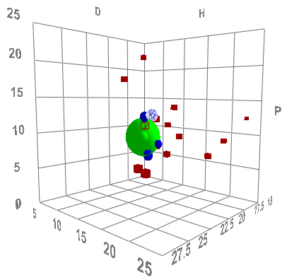
HSPiP for Predicting New Green Solvents
Experimental Data Set (Swelling)
Experimental Data Set (Swelling)
Rank Solvents Accordingly
Determine Optimal Solvent Parameters (HSPiP)
Predict Additional Green Solvents

Slide 20
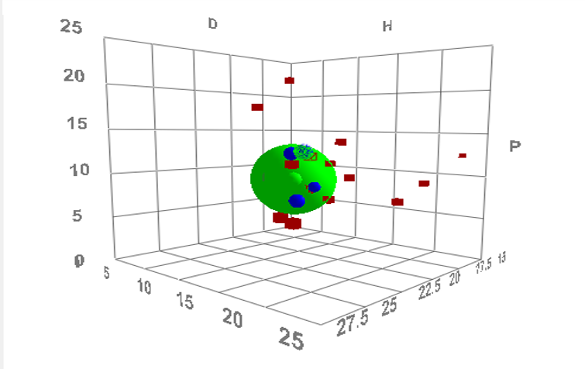
Solvent Ranking - Merrifield
  Solvents were ranked according to how well they were able to swell the particular resin
  Swelling grouping was determined by dividing the swelling range (S_{max}-S_{min}) by the number of ranks (n = 5)
  Solvents were sorted into groups based on the degree of swelling
  A ranked was then assigned to each group
  Data input into HSPiP
Swelling Groups (mL g⁻¹) | Solvent | Rank
5.40 – 6.30 | 2-MeTHF, NMP, DCM, CP | 1
4.50 – 5.40 | DMF | 2
3.60 – 4.50 |  | 3
2.70 – 3.60 | EtOAc | 4
1.80 – 2.70 | Cyrene, EC, PC, p-Cymene, D-limonene, Acetone, MeOH, EtOH, IPA | 5
Solvent | δD | δP | δH
CH₂Cl₂ | 17.00 | 7.30 | 7.10
2-MeTHF | 16.90 | 5.00 | 4.30
Predicted | 17.47 | 8.27 | 4.77
Polystyrene | 18.50 | 4.50 | 2.90

Slide 21
Predicted Optimal Solvent Parameters
  Optimised solvent parameters for each resin
  These can in turn be used to predict additional green solvents for resin swelling^{[9]}
Resin | δD | δP | δH | R
Merrifield | 17.47 | 8.27 | 4.77 | 4.9
ParaMax | 17.68 | 7.87 | 7.72 | 4.0
JandaJel | 17.30 | 9.16 | 4.09 | 3.4
TentaGel S RAM Fmoc | 17.72 | 10.82 | 6.41 | 1.7
ArgoGel | 17.68 | 10.93 | 6.40 | 1.7
HypoGel 200 | 17.57 | 12.02 | 8.68 | 3.9
NovalGel | 17.21 | 10.87 | 10.22 | 3.0
ChemMatrix | 18.60 | 9.82 | 6.98 | 1.0
SperiTide | 17.14 | 11.33 | 9.35 | 3.0
[9]. C. M. Alder et al., Green Chem., 2016, 18, 3879-3890.

Slide 22
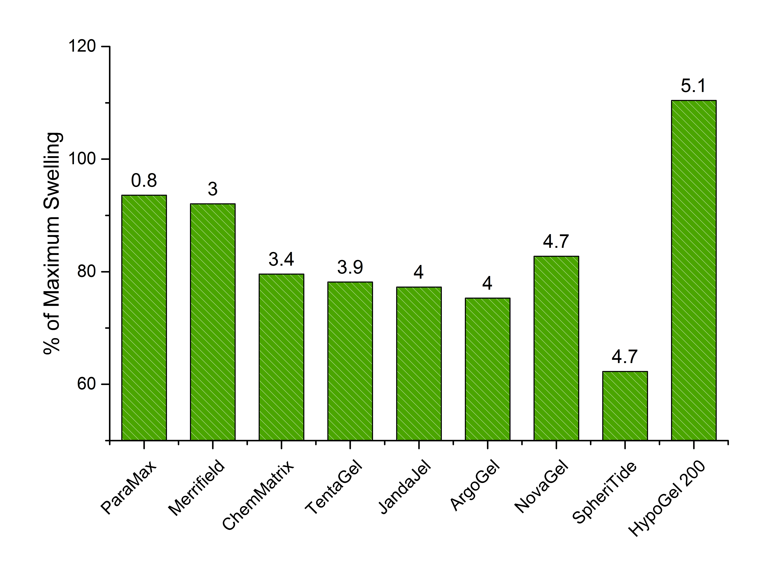
Swelling in Predicted Green Solvents
  Generally swelling falls the further a solvent lies in HSP space from the optimal solvent parameters

Slide 23
Conclusion
  The suitability of various green solvents for Solid-Phase Organic Synthesis (SPOS) has been investigated
  Adequate swelling of common SPOS resins by a green solvents has been observed in the majority of cases
  Experimental study of the solid-phase Ugi reaction was found to be consistent with solvent suitability
  HSPiP has been used successfully to predict optimal solvent parameters for each resin and suggest additional green solvents suitable for SPOS

Slide 24

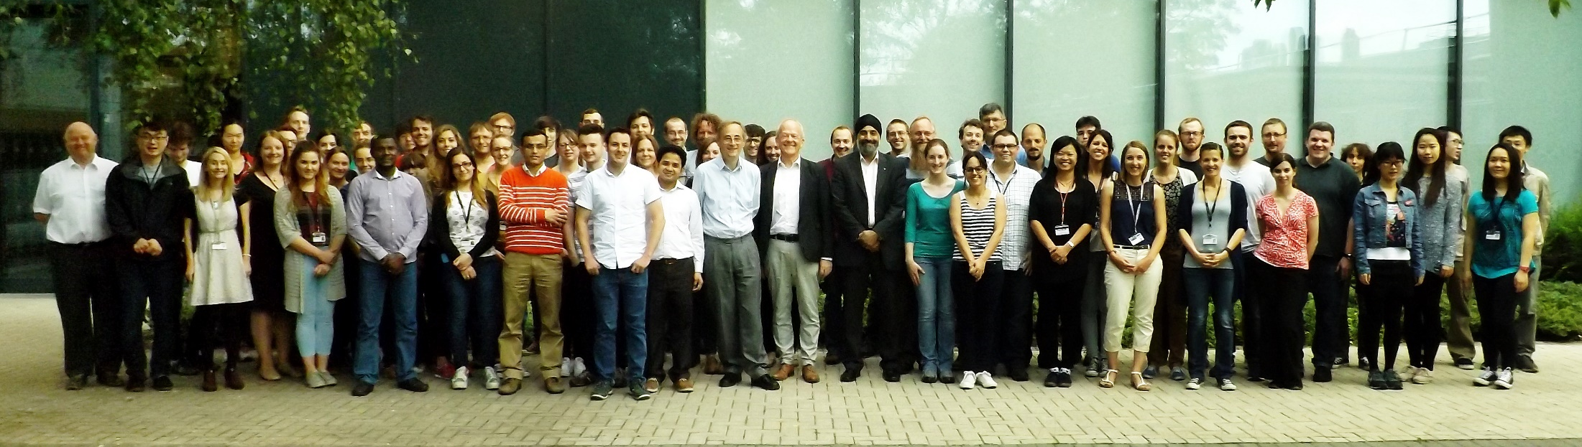
Acknowledgements
Professor Michael North
Dr Anne Routledge
Fanny Peigneguy
Helen Willway
EPSRC Studentship EP/M506680/1

